Slide 1

Traffic flow
Racing Theme
Part 1: Constant Lambda
Joel Chavali
Vistas In Advanced Computing
August 11, 2017

Slide 2



Description
Model of Traffic Flow along a single lane.
Only the first vehicle varies
Following vehicle’s are dependent on the previous vehicles speed and a constant
Constant determined by user.
This Photo by Unknown Author is licensed under CC BY

Slide 3
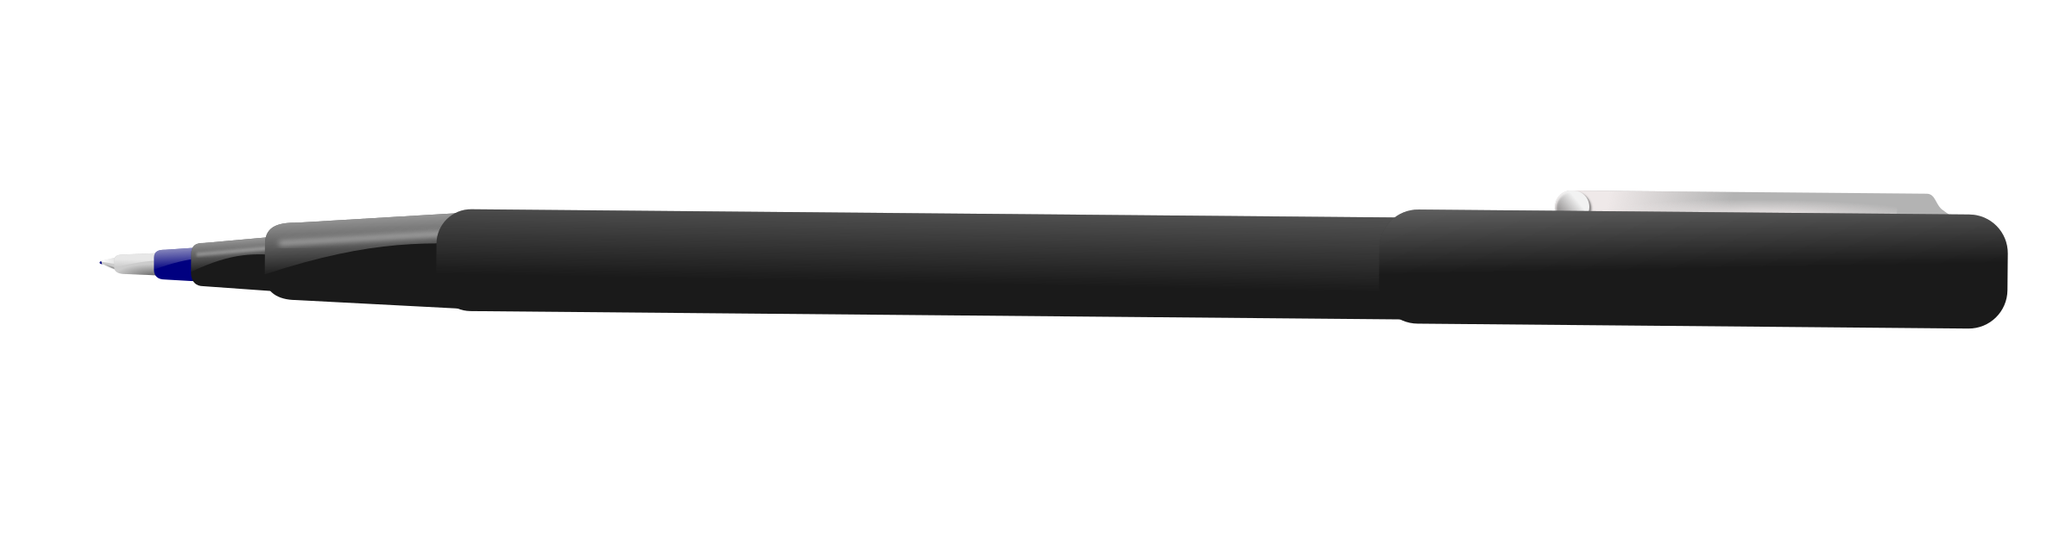
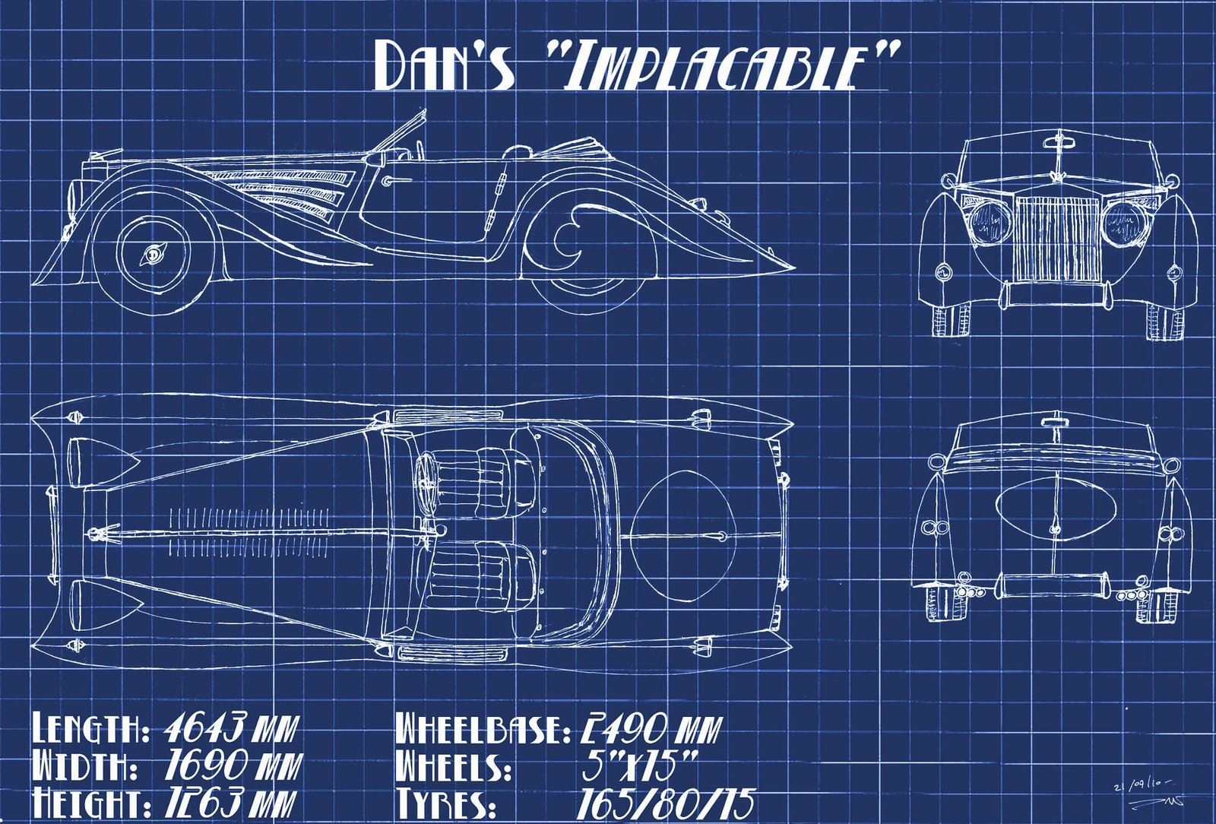

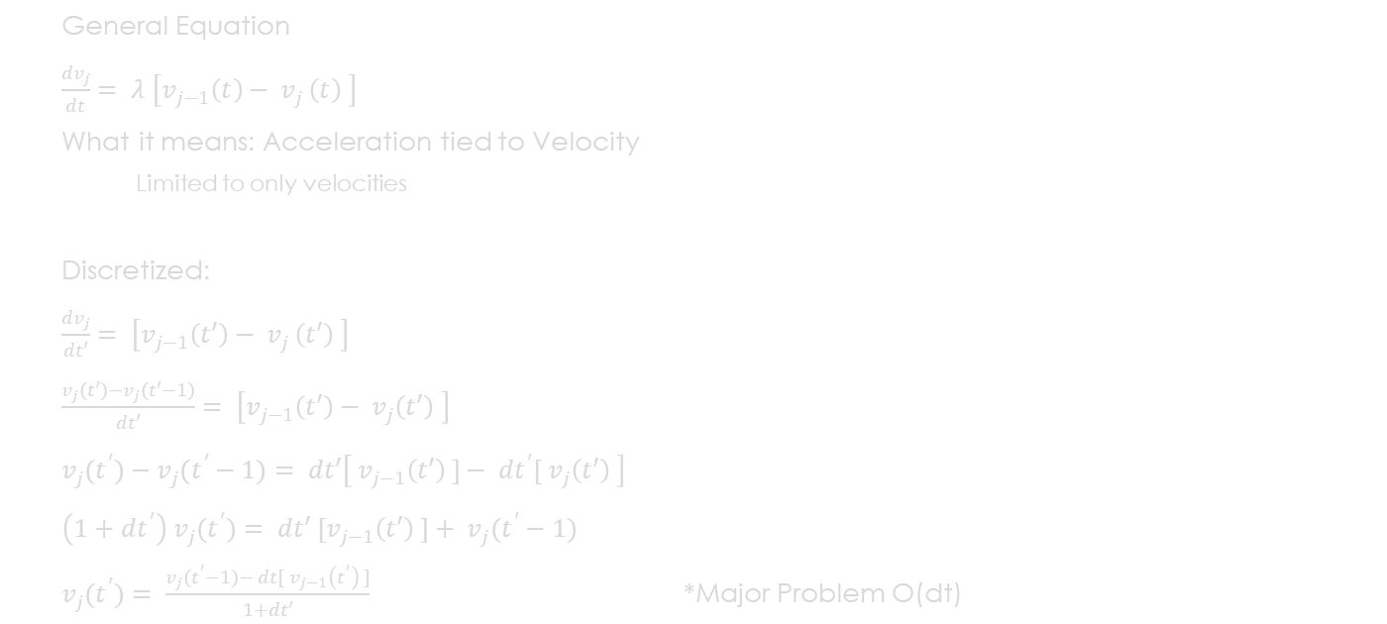
Mathematics and equations (Blueprints of the code)
General Equation
$\frac{{dv}_{j}}{dt}= λ \left[v_{j−1}\left(t\right)− v_{j }\left(t\right) \right]$
What it means: Acceleration tied to Velocity
Limited to only velocities
Discretized:
$\frac{{dv}_{j}}{dt′}= \left[v_{j−1}\left(t′\right)− v_{j }\left(t′\right) \right]$
$\frac{v_{j}(t′)−v_{j}(t′−1)}{dt′}= \left[v_{j−1}\left(t′\right)− v_{j}\left(t′\right) \right]$
$v_{j}(t^{′})−v_{j}(t^{′}−1)= dt′\left[ v_{j−1}\left(t′\right) ]− dt^{′}[ v_{j}\left(t′\right) \right]$
${\left(1+dt^{′}\right) v}_{j}(t^{′})= dt′ [v_{j−1}\left(t′\right) ]+ v_{j}(t^{′}−1)$
$v_{j}(t^{′})= \frac{v_{j}(t^{′}−1)− dt[{ v}_{j−1}\left(t^{′}\right) ]}{1+dt′}$ *Major Problem O(dt)
Legend of Symbols
$$\frac{{dv}_{j}}{dt}$$ | Acceleration of the jth vehicle
$$λ$$ | Constant that user defines
$$v_{j−1}(t)$$ | Real Time Speed of Previous Car
$v_{j}$(t) | Real Time Speed of Current Car

Slide 4
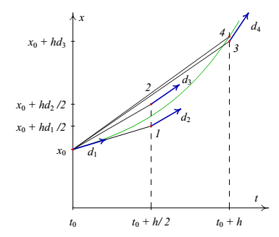
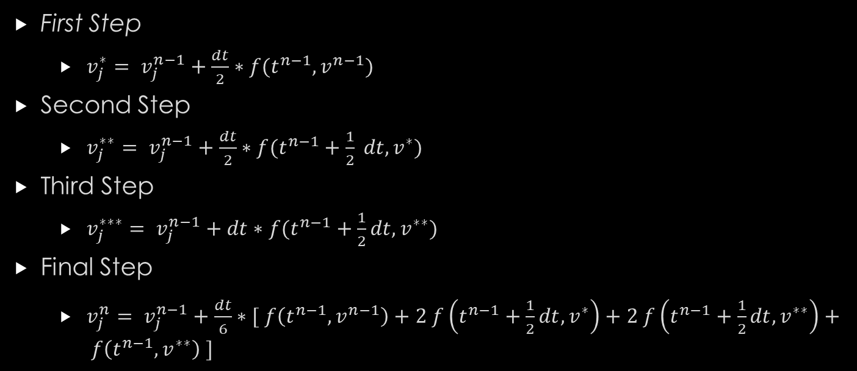
Runge-kutta 4th Order Pseudocode
Picture of Runge-Kutta
Computer Code/Big Number Crunch
Computer Graphics Car or Unveiling
First Step
$v_{j}^{∗}= v_{j}^{n−1}+\frac{dt}{2}∗f(t^{n−1},v^{n−1})$
Second Step
$v_{j}^{∗∗}= v_{j}^{n−1}+\frac{dt}{2}∗f(t^{n−1}+\frac{1}{2} dt,v^{∗})$
Third Step
$v_{j}^{∗∗∗}= v_{j}^{n−1}+dt∗f(t^{n−1}+\frac{1}{2}dt,v^{∗∗})$
Final Step
$v_{j}^{n}= v_{j}^{n−1}+\frac{dt}{6}∗[ f\left(t^{n−1},v^{n−1}\right)+2 f\left(t^{n−1}+\frac{1}{2}dt,v^{∗}\right)+2 f\left(t^{n−1}+\frac{1}{2}dt,v^{∗∗}\right)+ f\left(t^{n−1},v^{∗∗}\right) ]$

Slide 5

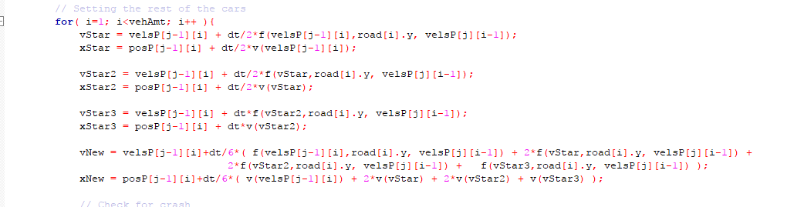
Implementation
Problem about Displacement
Order of Magnitude of Error
Planetary Motion Example
Code

Slide 6
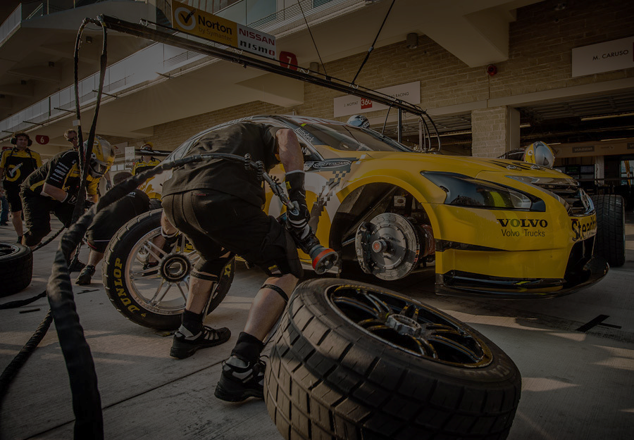
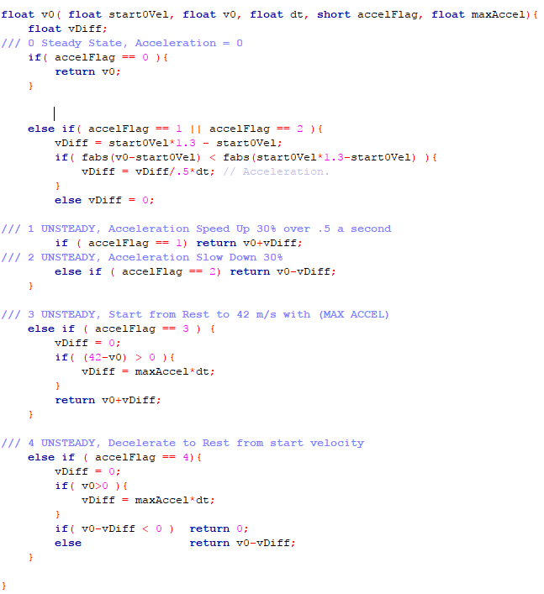
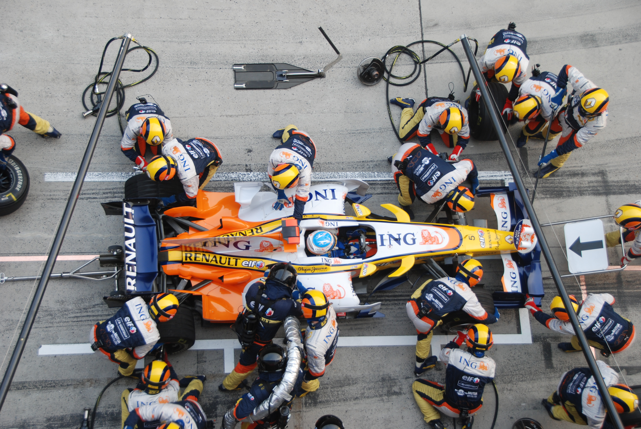
Implementation – Specifications
Maximum Time: Limit 37 s
Change in Time: 0.10 s (for video purposes)
Max Acceleration: 7.276 m/s² ( 23.87 ft/s²)
Max Velocity: 49.174 m/s ( 110 mph )
Initial Velocity: 30.0 m/s ( 67.1 mph )
Ind. Vehicle Length: 4.80 m ( 15.7 feet )
Lambda: 0.90
Picture of Code,
Picture of Functions

Slide 7

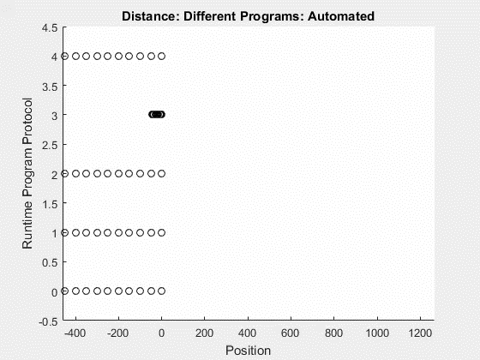
Scenario overviews

Slide 8
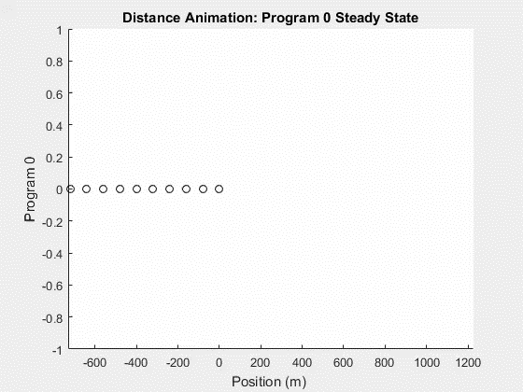
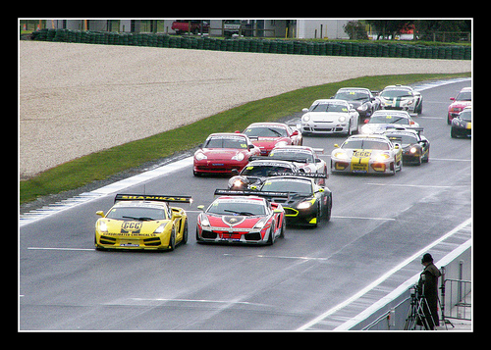
Steady state
All vehicles remain at initial velocity for the entire interval.
Kind of boring
Program Specs:
Time: 30 s
dt: 0.1 s
Lambda: 0.90
Veh Length: 4.80 m
Init Sep Dist: 80.00 m
Init Vel: 30.00 m/s

Slide 9
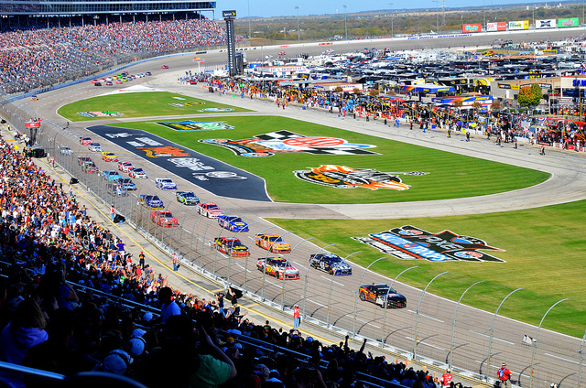
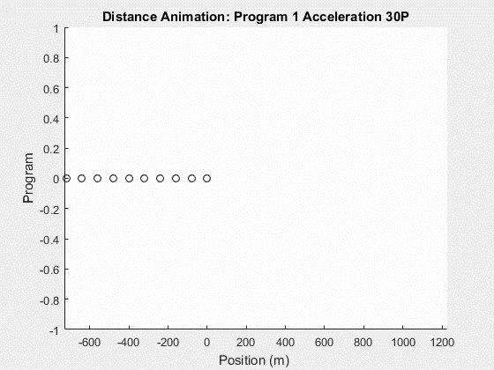

Acceleration
Vehicles accelerate 30% from a steady state.
More Realistic, Everyday Driving
Small Increases and Decreases in speed due to road.
Program Specs:
Time: 30 s
dt: 0.1 s
Lambda: 0.90
Veh Length: 4.80 m
Init Sep Dist: 80.00 m
Init Vel: 30.00 m/s

Slide 10
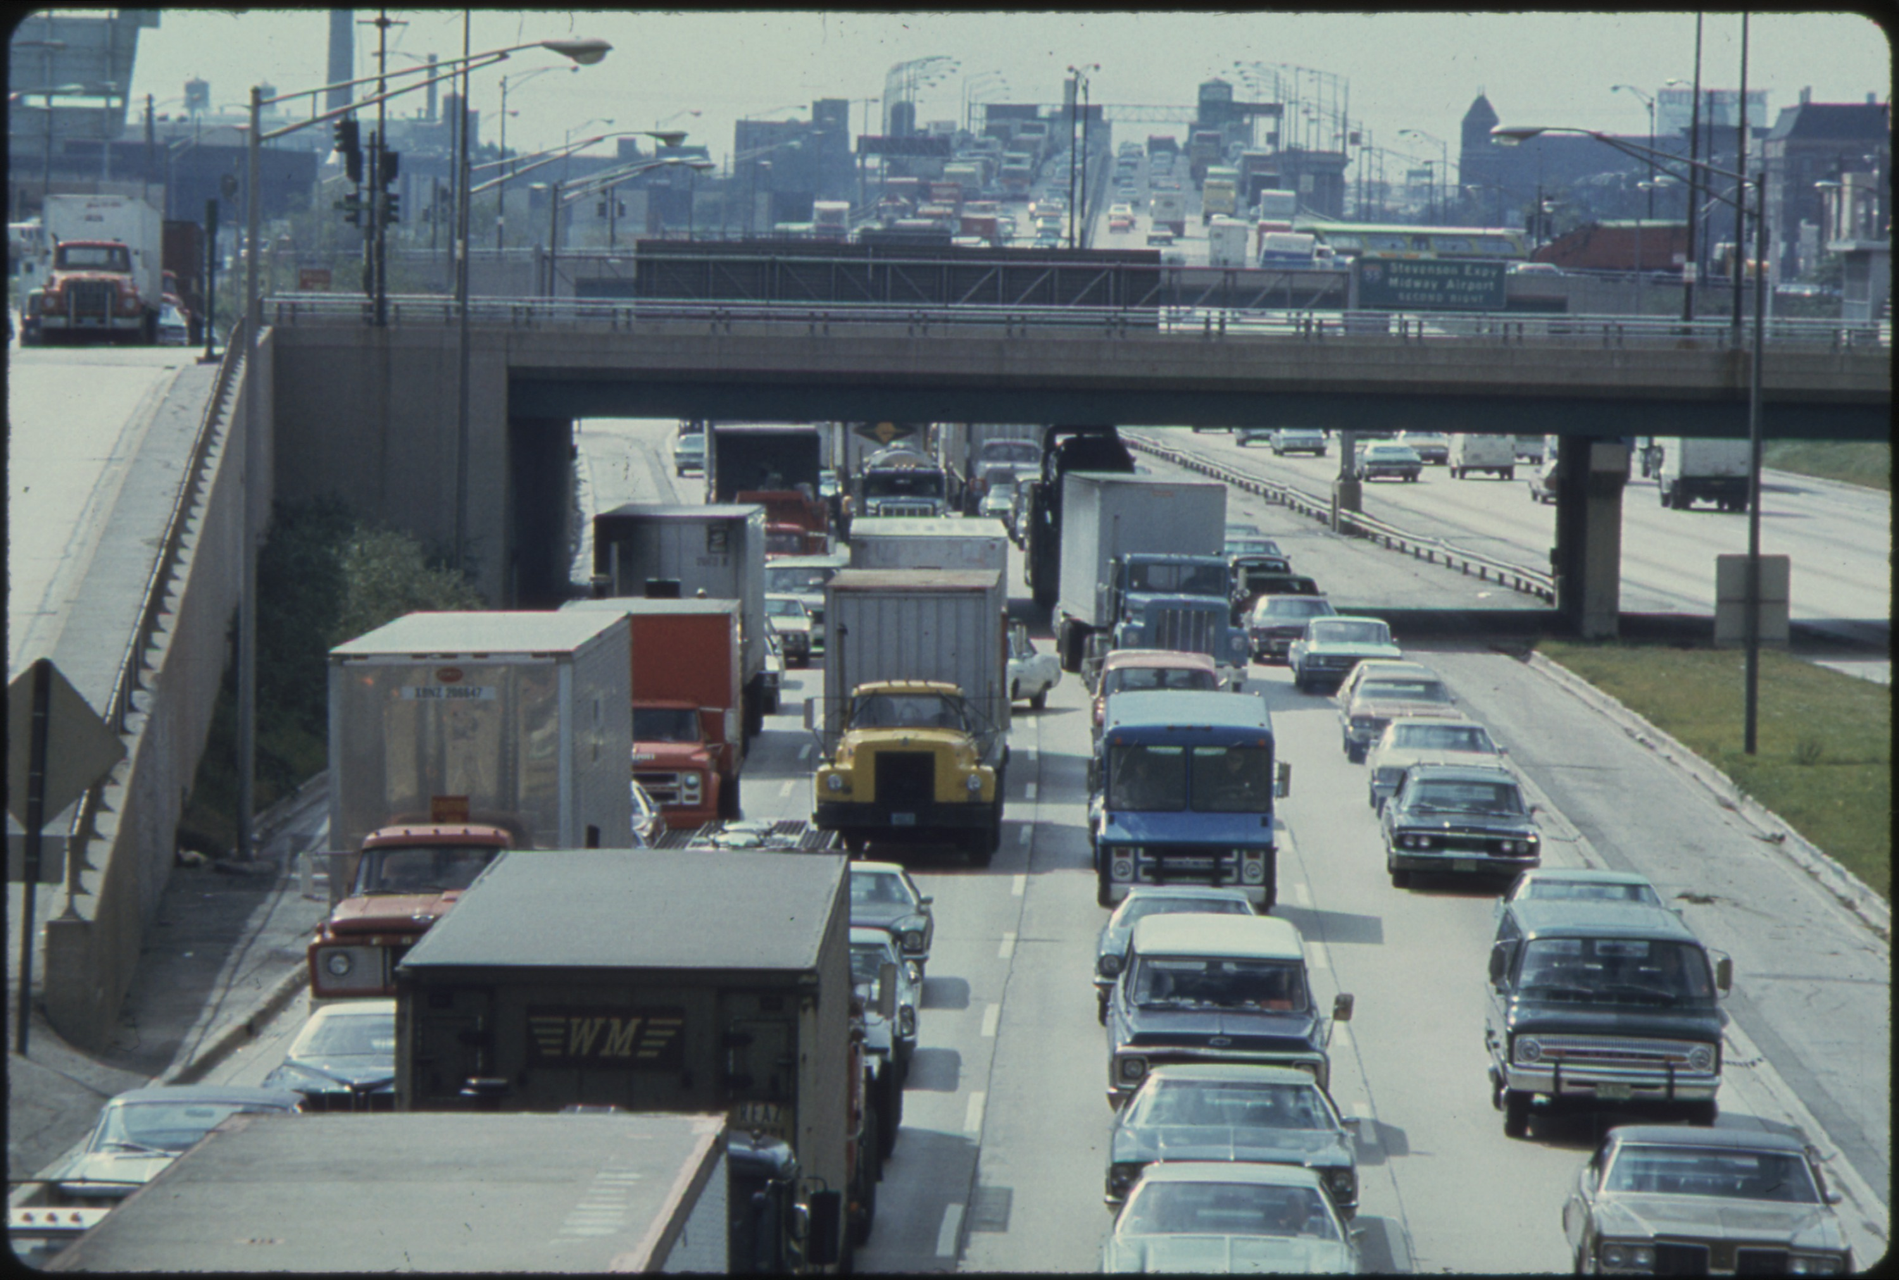
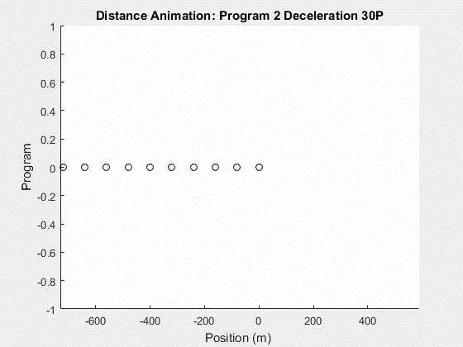
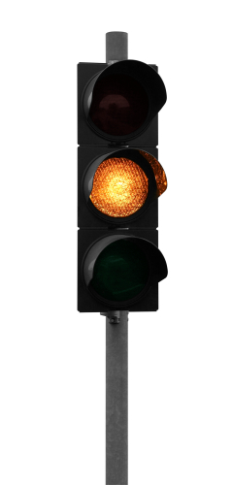
Deceleration
Vehicles decelerate 30% from a steady state.
More Realistic, Everyday Driving
Small Increases and Decreases in speed due to road.
Program Specs:
Time: 30 s
dt: 0.1 s
Lambda: 0.90
Veh Length: 4.80 m
Init Sep Dist: 80.00 m
Init Vel: 30.00 m/s

Slide 11
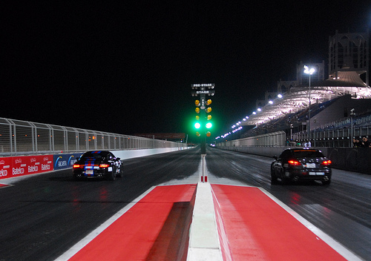
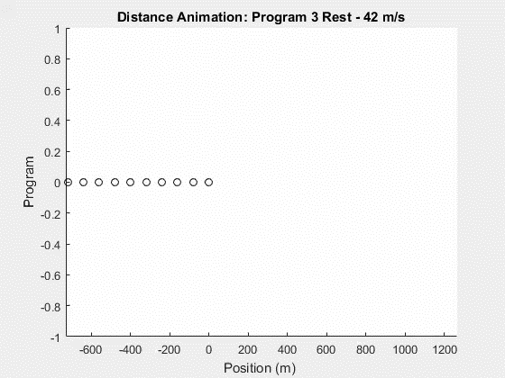

accelerating from Rest
Lane of cars accelerate to 42 m/s from rest.
Real Life, Happens briefly at lights, Highway On Ramps
Program Specs:
0 -> 42 m/s
Time: 30 s
dt: 0.1 s
Lambda: 0.90
Veh Length: 4.80 m
Init Sep Dist: 80.00 m

Slide 12


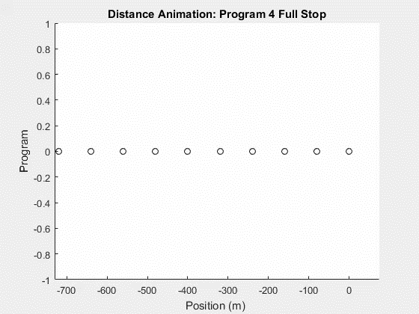
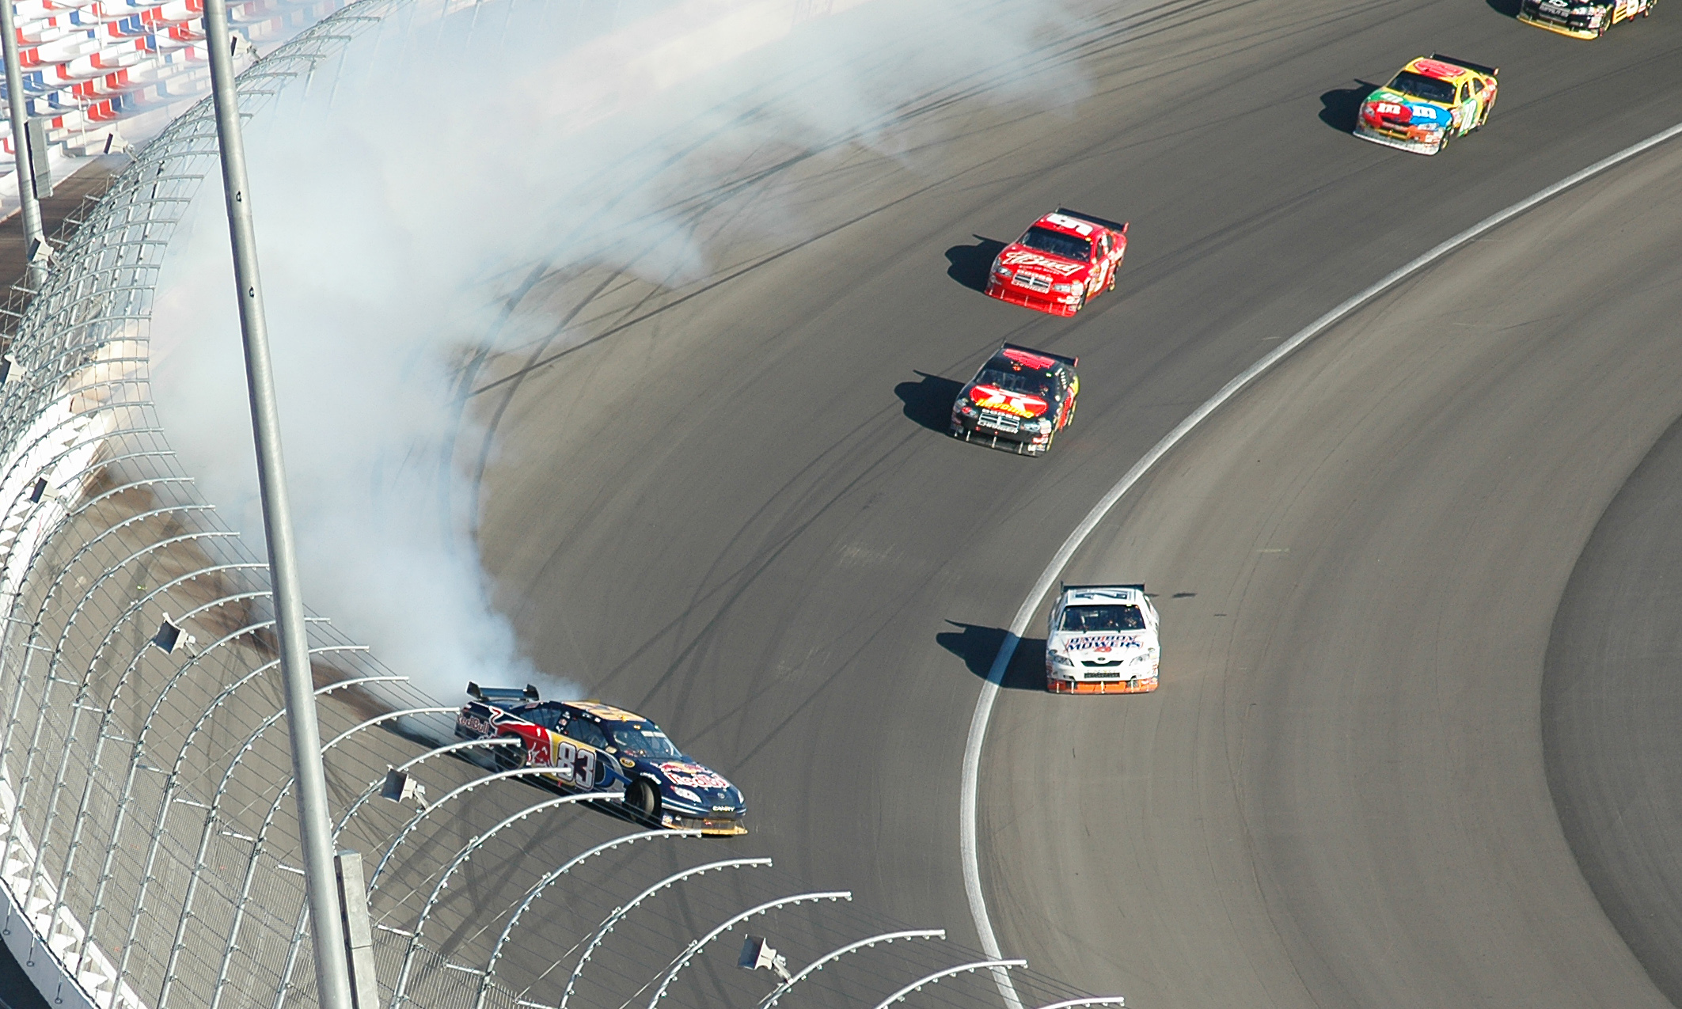
Decelerating to a stop
Line of vehicles decelerates to rest at their maximum braking power.
Usually only in Emergency Stopping
Responding to Crashes
Pedestrian or Obstruction
Program Specs:
30 -> 0 m/s
Time: 30 s
dt: 0.1 s
Lambda: 0.90
Veh Length: 4.80 m
Init Sep Dist: 80.00 m
This Photo by Unknown Author is licensed under CC BY-SA

Slide 13
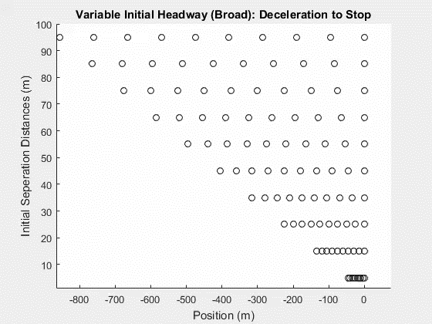
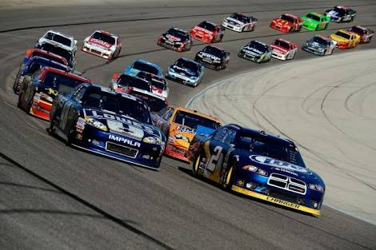
Changing initial position (Broad)
Varying the Initial Separation Distance
Optimize Traffic Loads on Roads
Model Specifications
Decelerate to Stop
Time: 30 s
dt: 0.1s
Lambda: 0.9
Veh Length: 4.80 m
Initial Velocity 30 m/s
Vid Goes Here
Cars Spread Out

Slide 14
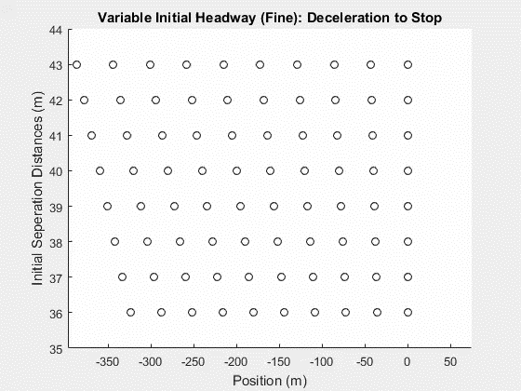
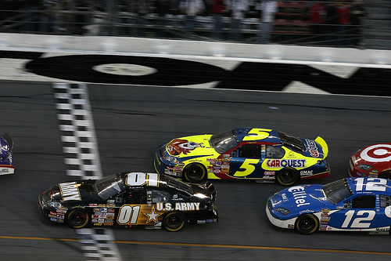
Changing initial position (fine)
Vid Goes Here
Cars Bumper to Bumper
Model Specifications
Decelerate to Stop
Time: 30 s
dt: 0.1s
Lambda: 0.9
Veh Length: 4.80 m
Initial Velocity 30 m/s
Min Sep Dist: 37 m
Practical Sep Dist: 50 m
Limitations
Reaction Time
Mechanical Delay

Slide 15
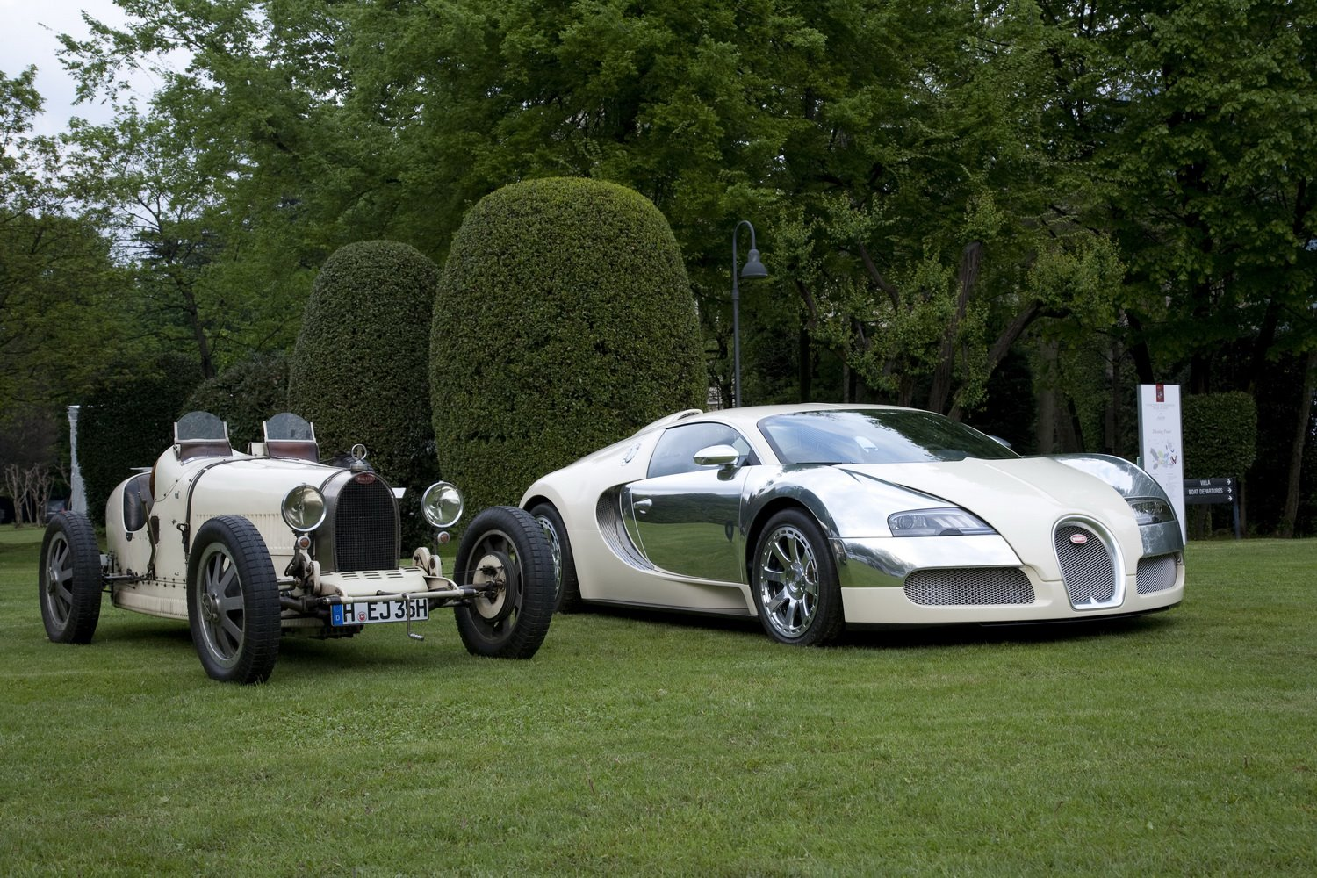
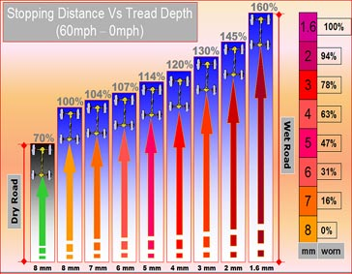
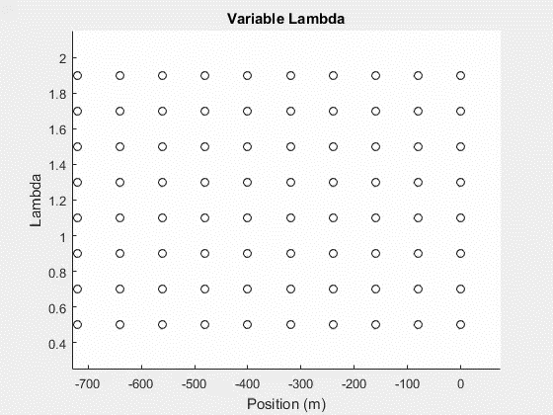
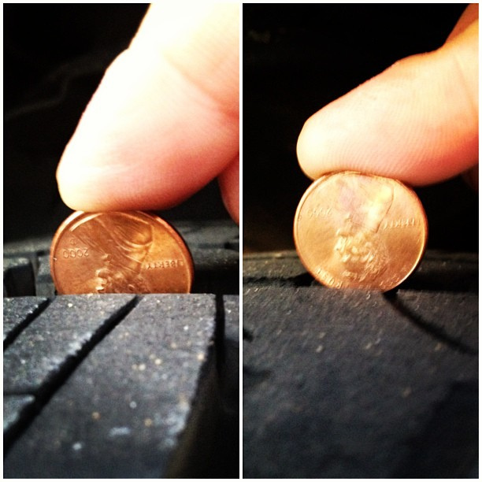
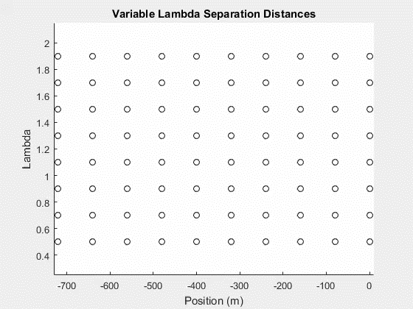
Changing lambda
Increase Lambda
Quicker Reactions
Maintained Separation (Equation)
Limitations
Maintained Separation
Model Specifications
Decelerate to Stop
Time: 30 s
dt: 0.1s
Headway: 80 m
Veh Length: 4.80 m
Initial Velocity 30 m/s
This Photo by Unknown Author is licensed under CC BY

Slide 16
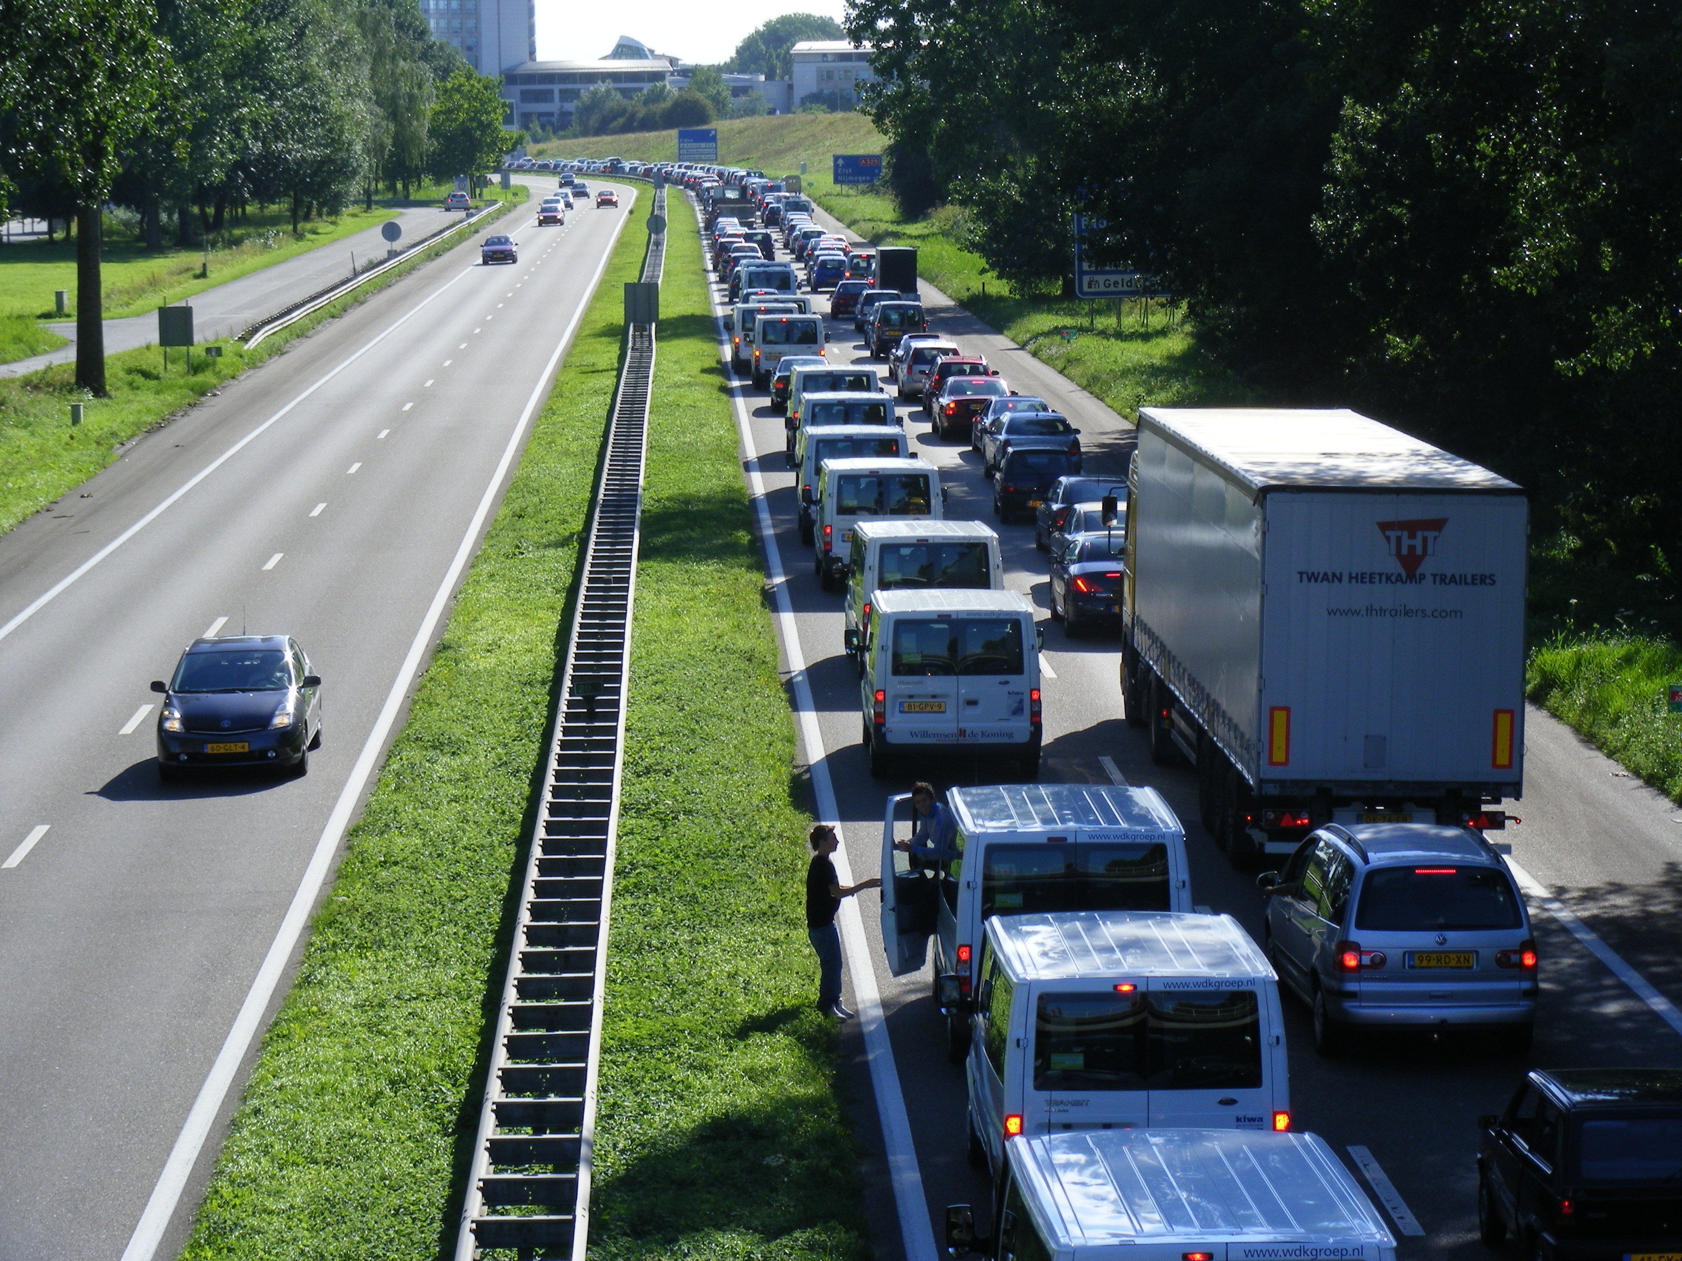
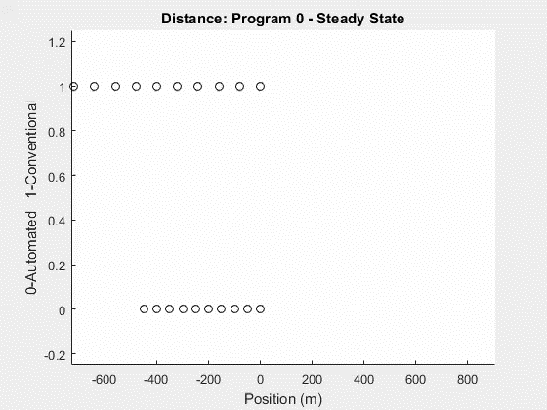
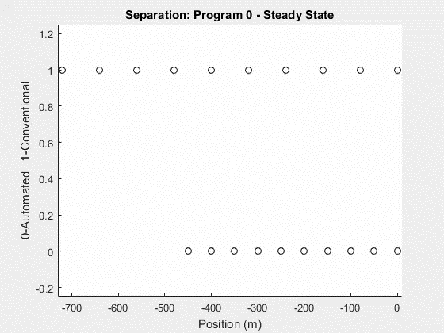
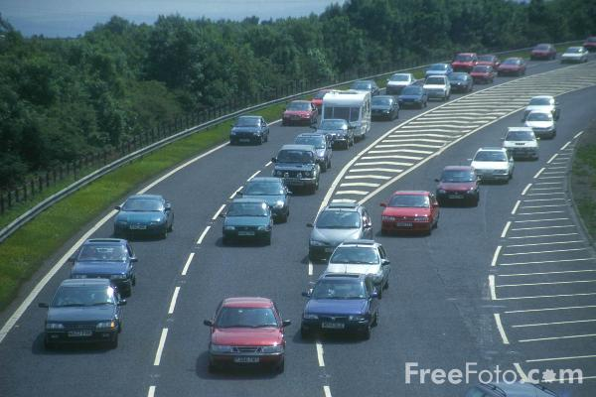
Comparing conventional vs optimized traffic
Optimization Increases Traffic Loads on Roads.
This Photo by Unknown Author is licensed under CC BY-NC-ND
This Photo by Unknown Author is licensed under CC BY-SA

Slide 17
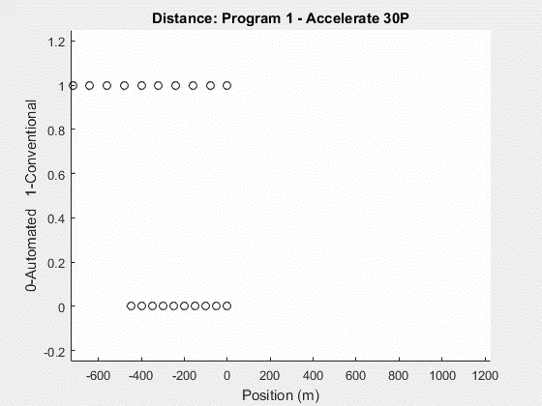

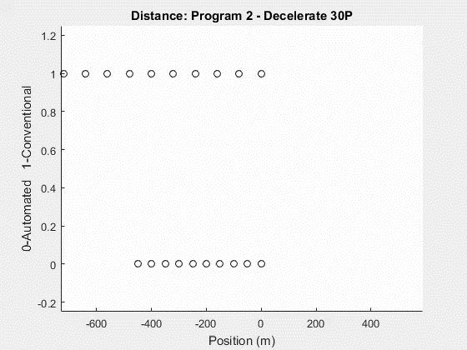

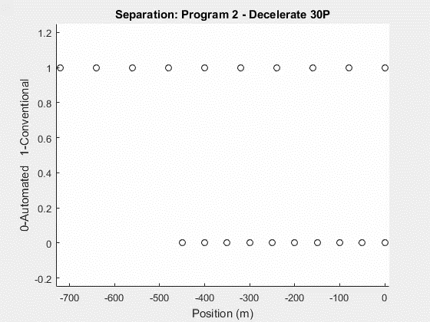
Comparing conventional vs optimized traffic
Model Specifications: Time: 30 s, dt: 0.1s, Lambda: 2.3, Headway: 50 m, Initial Velocity 30 m/s
Acceleration and Deceleration: Smaller Headway yet
maintaining safety.

Slide 18
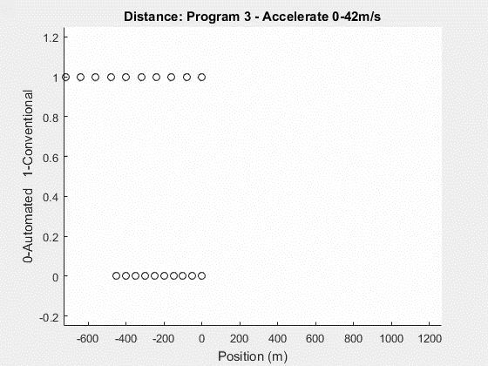
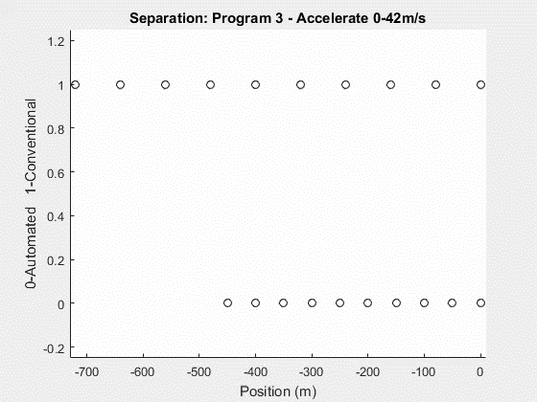
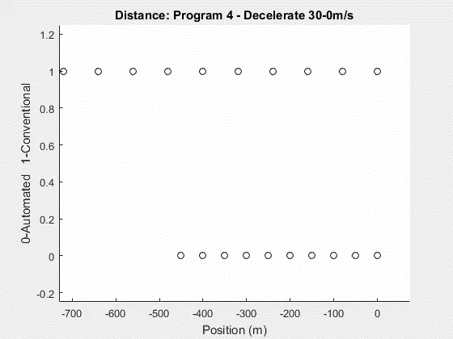

Comparing conventional vs optimized traffic
Emergency Acceleration and Deceleration: Still
keeping passengers safe while adding more space for
larger roads capacity

Slide 19
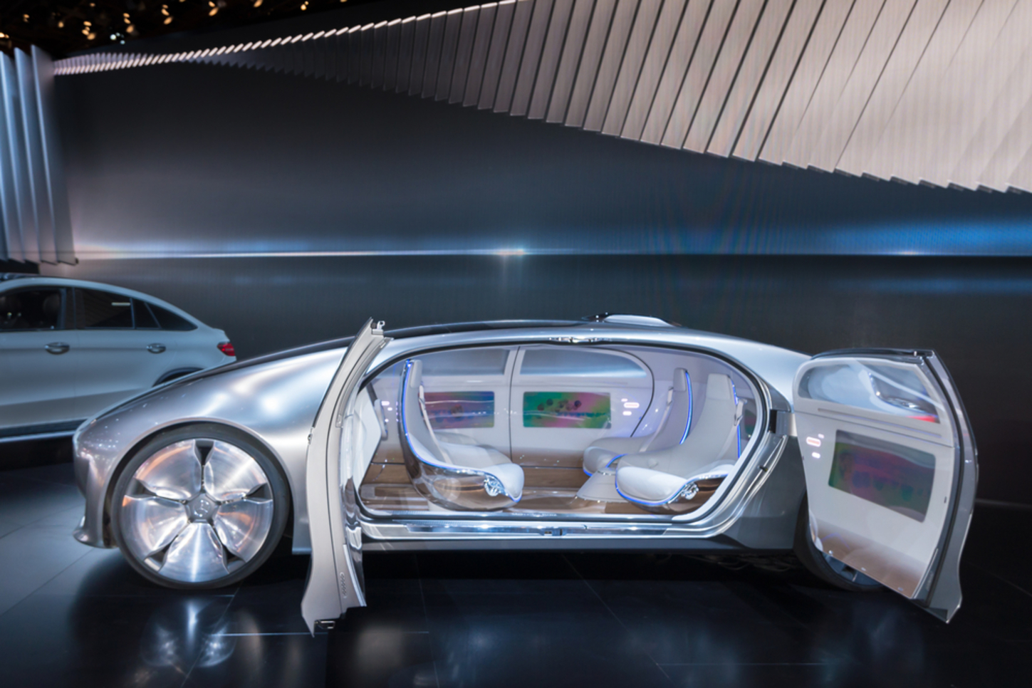
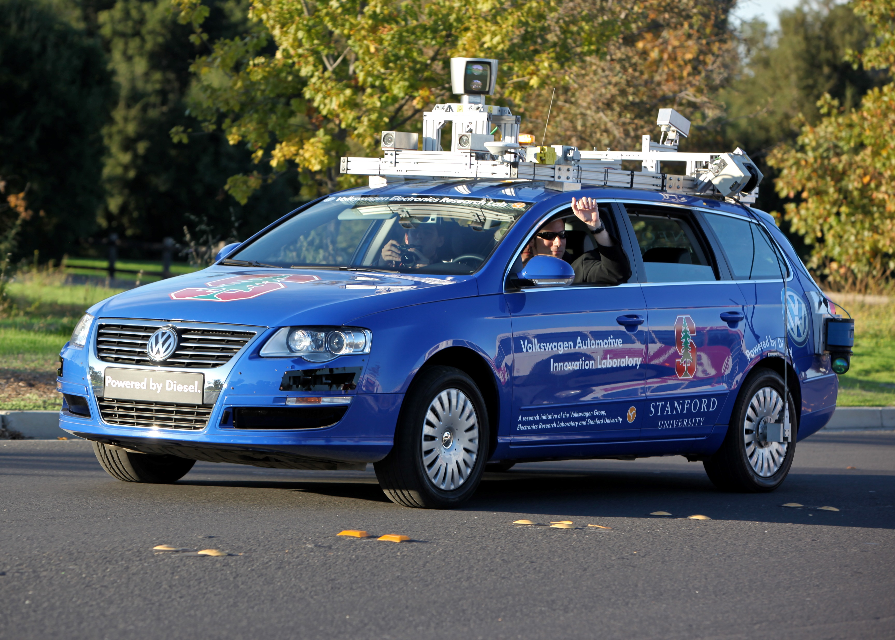
Applications Of Model
Humans too irregular
Automated Traffic is much more
Precise
Knowledgeable about neighbors
Used to find maximum load of a single lane highway
Maintain Safety Above All
Automated Car

Slide 20
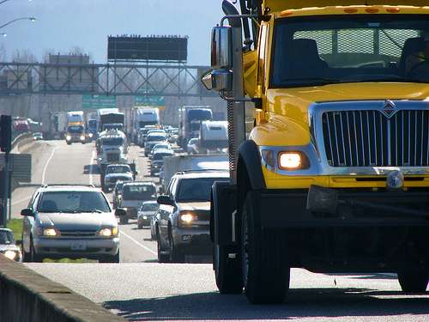
Multi – Create and Run future goals of model
Learned how to Create and Run Multiple Files at once w/ little user interaction
Model has capability to run with different vehicle specifications
Lambda
Initial Velocity
Initial Separation Distance
Vehicle Length
Maximum Acceleration
Maximum Velocity

Slide 21

Sources
https://www.michigan.gov/documents/msp/BrakeTesting-MSP_VehicleEval08_Web_221473_7.pdf
https://assets.publishing.service.gov.uk/media/559afa50ed915d1592000026/the-highway-code-stopping-distances.jpg

